Slide 1



M/s. Mother India Life Spaces and Infra Engineering Limited, INDIA.
(Deals in Exports: All Agricultural Food Products, FMCG., Construction Materials, Textiles and Garments)
The Reverse Buyer – Seller Meet (RBSM)
On dated: 18.02.2025 & 19.02.2025
Radisson Blu Resorts, Visakhapatnam.

Slide 2


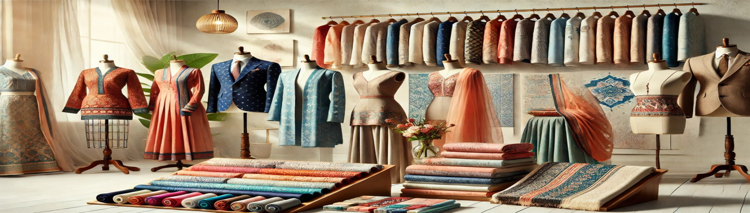
Textiles and Garments
"The Art of Textiles, The Craft of Fashion"

Slide 3

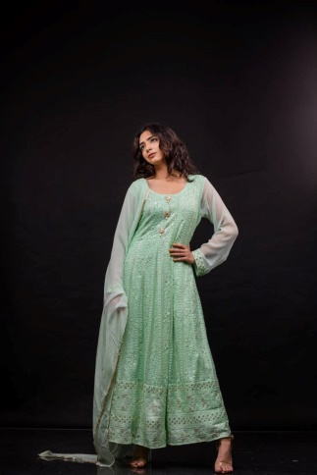

1. Chiffon
The Ethereal Elegance
Chiffon is a light, airy fabric that gracefully dances with every breeze.
It’s often used in elegant evening wear, such as beautiful gowns, flowy dresses, delicate scarves, and sheer blouses.
Its slightly rough texture, due to the twists in the yarns, provides a comfortable grip, making it a favored choice for creating layered looks that require both form and function.
Chiffon’s see-through quality adds a touch of allure, while its resilience against wear makes it suitable for extended use.
Light, airy fabric used in evening wear, scarves, and blouses.

Slide 4
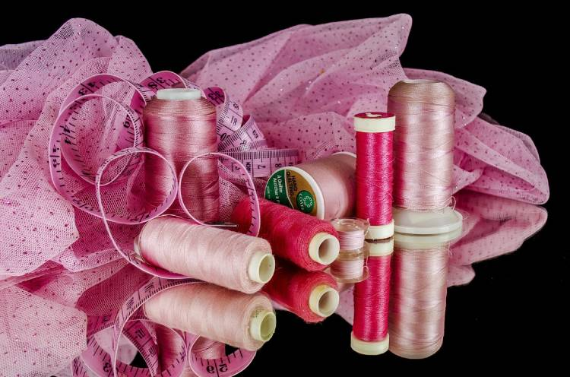
2. Cotton
The Everyday Comfort
Cotton: Cotton, a fabric celebrated for its comfort and breathability, is a cornerstone in both fashion and home textiles.
It’s exceptionally versatile, finding its way into a wide array of products like durable work clothes, soft bed linens, and plush towels.
Cotton’s hypoallergenic nature makes it a gentle choice for sensitive skin, and its ability to hold up well against repeated washings ensures longevity.
From crisp shirts to cozy quilts, cotton’s adaptability makes it indispensable.
Soft, breathable, hypoallergenic fabric used in fashion and home textiles.

Slide 5

3. Crepe
The Crinkled Charm
Crepe offers a distinctively textured feel, combining elegance with ease.
Its slightly crinkled surface and graceful drape make it ideal for creating flowing dresses, sophisticated pants, and stylish tops.
Crepe resists wrinkling and shrinking, which adds to its appeal for both casual and formal wear.
Available in various weights, it can be adapted for different seasons, providing a year-round fabric choice that blends comfort with a touch of class.
Textured, wrinkle-resistant fabric ideal for elegant and casual wear.

Slide 6
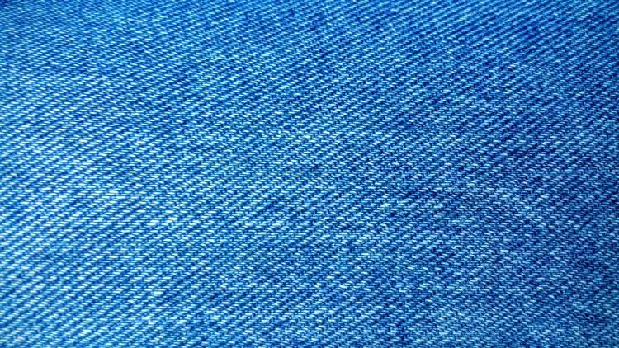
4.Denim
The Rugged Staple
Denim’s global popularity stems from its exceptional durability and timeless appeal.
Originally used for workwear, it has evolved into a fashion staple, appearing in countless forms from rugged jeans to chic jackets.
Denim’s ability to age gracefully, developing a unique character with wear, makes each piece a personal statement.
It’s also versatile, blending with various styles and trends, making it a fabric that continuously reinvents itself.
Durable, timeless fabric used for jeans, jackets, and workwear.

Slide 7
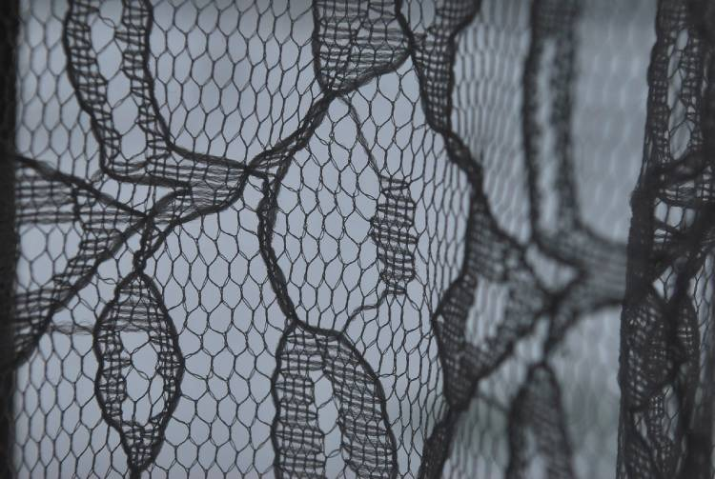
5. Lace
The Delicate Artistry
Lace, a fabric synonymous with refinement and grace, is made with precision and care.
Its intricate patterns range from floral to geometric, each piece telling a story of craftsmanship.
Lace adds a touch of femininity to any garment or décor, from bridal gowns to elegant tablecloths.
The variety in lace types, from needle lace to bobbin lace, provides a wide spectrum of styles suited for different occasions and tastes.
Delicate, intricate fabric used in bridal gowns and decorative textiles.

Slide 8
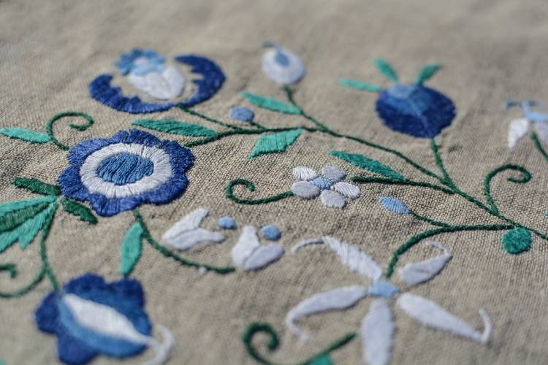
6. Linen
The Crisp Natural
Linen, a fabric known for its natural elegance and durability, is made from flax fibers.
It’s valued for its exceptional coolness and freshness in hot weather, making it a favorite for summer clothing and light bedding.
Linen’s natural slubs add character to its texture, while its ability to soften with each wash makes it increasingly comfortable over time.
Its ecological footprint, being biodegradable and requiring less water and pesticides than cotton, adds to its appeal.
Crisp, breathable fabric perfect for summer clothing and bedding.

Slide 9
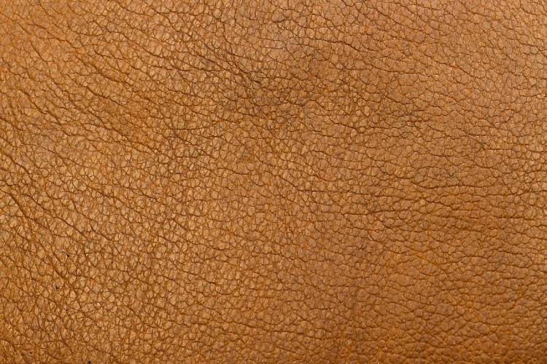
7. Leather
The Timeless Tough
Leather: Leather, a material as old as civilization, continues to be a symbol of durability and luxury.
Its natural toughness makes it ideal for items that need to withstand wear and tear, like shoes, belts, and jackets. Leather’s ability to age beautifully, developing a unique patina over time, adds to its charm.
Its versatility in finishes and colors allows for a range of styles, from rugged and rustic to sleek and sophisticated.
Durable and luxurious material used in shoes, belts, and jackets.

Slide 10
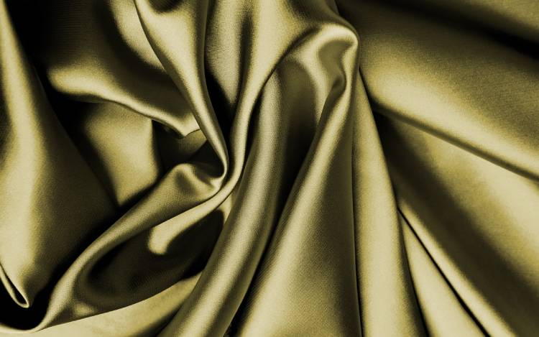
8. Satin
The Sleek Smoothness
Satin, with its glossy surface and luxurious feel, exudes opulence.
It drapes beautifully, making it a popular choice for evening gowns, bridal wear, and elegant bedding.
Satin’s smoothness reduces friction, which is beneficial for hair and skin when used in pillowcases and lingerie.
Its insulating properties keep it cool in summer and warm in winter, enhancing its appeal for year-round use.

Slide 11
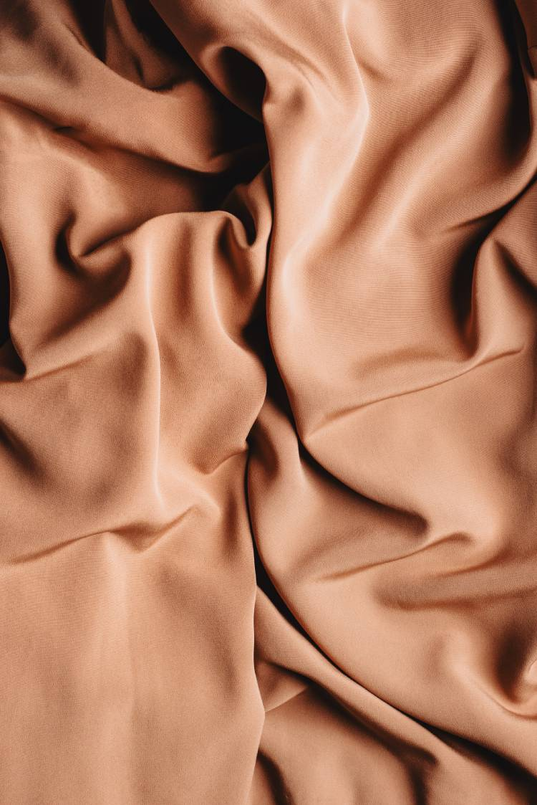
9. Taffeta
The Rustic Shine
Taffeta is a crisp, stiff fabric with a distinctive rustle, often used in ball gowns, wedding dresses, and high-end home décor.
Its high-twist yarns give it a slight sheen, adding a touch of luxury to any design.
Taffeta holds its shape well, making it ideal for structured garments and decorations that require a voluminous look.
It’s also water-resistant, adding a practical dimension to its elegance.

Slide 12
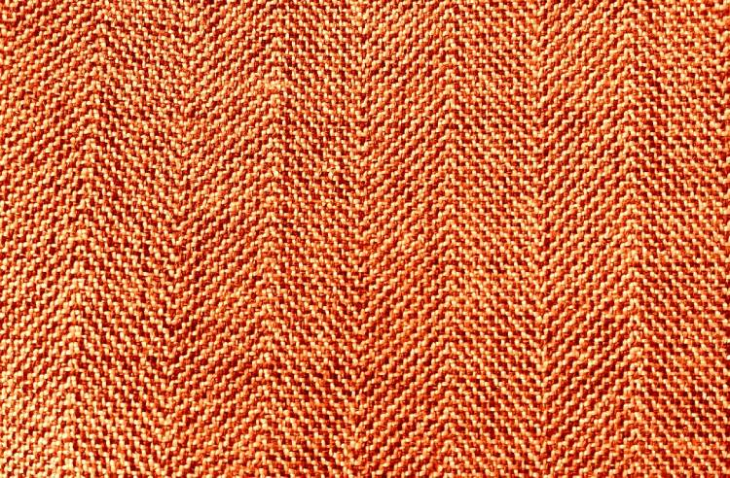
10. Tweed
The Textured Tradition
Tweed, originating from Scotland, is renowned for its robust, textured weave.
This fabric’s durability and moisture-resistant properties make it perfect for outdoor wear, such as coats and jackets.
Tweed’s traditional patterns, like herringbone and plaid, exude a classic charm, while contemporary variations offer a modern twist.
Its natural warmth and breathability make it a staple for cold-weather fashion.
Textured, warm fabric used in coats and jackets.

Slide 13
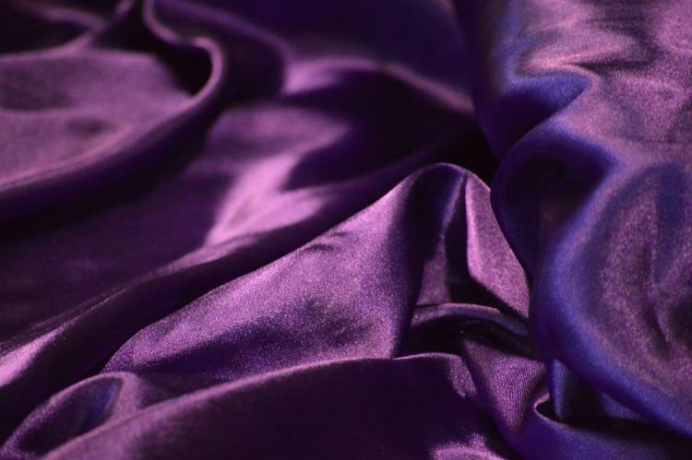
11. Silk
The Luxurious Sheen
Silk, renowned for its smooth texture and natural sheen, epitomizes luxury.
Its natural protein fibers provide an unparalleled softness, making it highly sought after for high-end fashion, from elegant dresses to premium neckties.
Silk’s thermal regulation properties offer warmth in the winter and coolness in summer, making it a versatile choice for various clothing types.
Its graceful drape and natural lustre also make it a popular choice for luxurious bedding and opulent interior decorations.
Luxurious, soft fabric with thermal properties for fashion and décor.

Slide 14
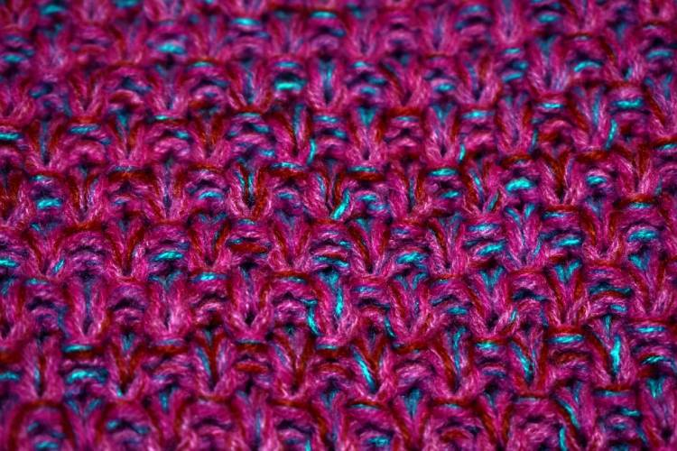
12. Synthetic Fabrics
The Modern Innovation
Synthetic fabrics, encompassing a wide range of materials like polyester, nylon, and acrylic, are marvels of modern textile technology.
These fabrics offer unique attributes such as moisture-wicking, stretchability, and durability.
They are extensively used in activewear, outdoor gear, and fashion that demands high performance.
Additionally, synthetic fabrics often mimic natural Fibers at a more affordable cost, making them accessible for various applications.
Modern textiles like polyester, nylon, and acrylic used in activewear and fashion.

Slide 15
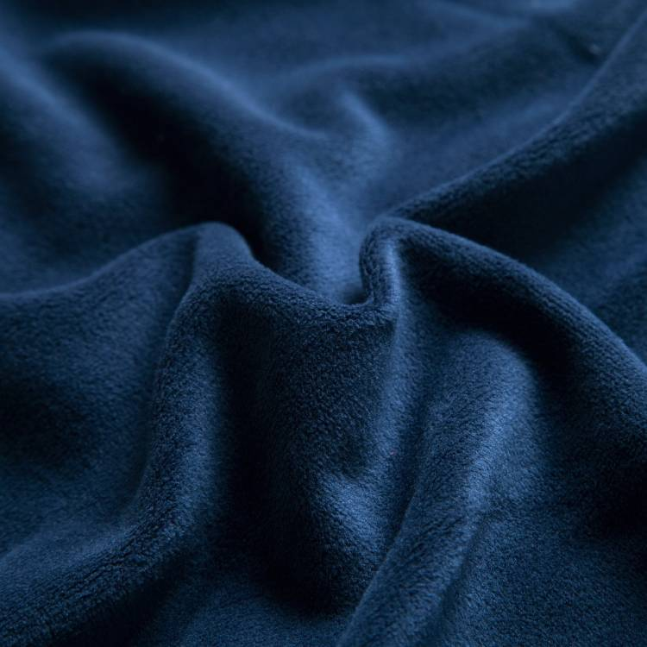
13. Velvet
The Rich Texture
Velvet, with its distinguished soft pile and rich texture, has been a symbol of nobility and luxury for centuries.
Used in everything from opulent curtains to sophisticated evening wear, velvet’s unique way of catching the light gives it a dynamic appearance.
The fabric’s warmth and depth make it a popular choice for colder seasons, both in fashion and home décor.
Rich, soft pile fabric used in fashion and upholstery.

Slide 16
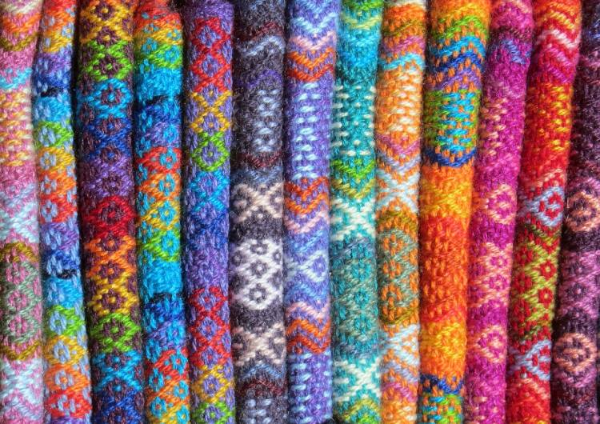
14. Wool
The Warm Embrace
Wool, a natural fiber harvested from sheep and other animals, is prized for its warmth and durability.
Its natural crimp creates insulating air pockets, making it ideal for winter wear like coats, sweaters, and scarves.
Wool is also moisture-wicking and odor-resistant, making it functional for activewear and outdoor apparel.
Its versatility extends to home furnishings, including cozy blankets and rich carpets.
Warm, insulating fabric used in winter clothing and furnishings.

Slide 17
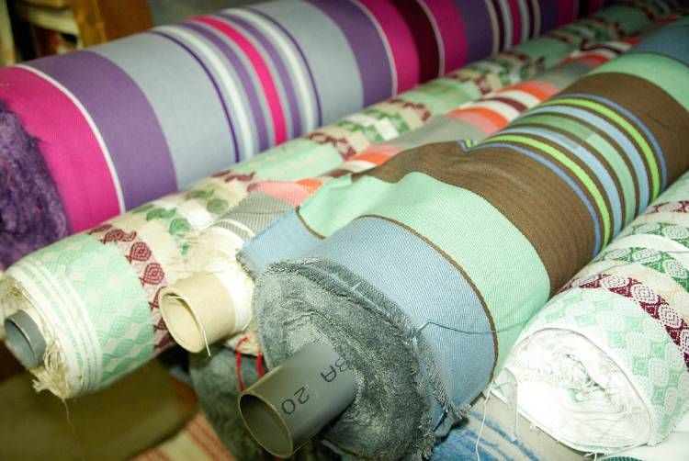
15. Canvas
The Sturdy Companion
Canvas: Canvas, known for its sturdiness and durability, is widely used in items that require resilience, like tents, sails, and backpacks.
Its heavy-duty quality also makes it a favorite for casual shoes and artist canvases.
Canvas can be made from cotton or linen, providing a robust platform for painting and a reliable material for hard-wearing accessories.
Sturdy, durable fabric used in bags, shoes, and artwork.

Slide 18
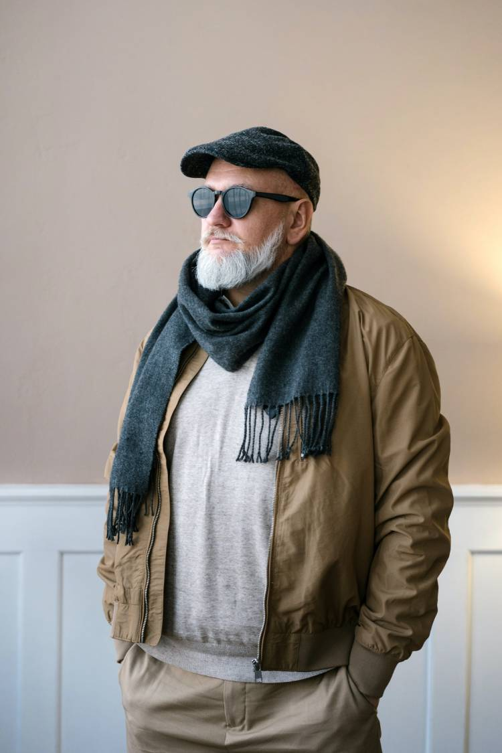
16. Cashmere
The Soft Luxury
Cashmere, derived from the soft undercoat of cashmere goats, is celebrated for its exceptional softness and lightweight warmth.
Its fine fibers make it one of the most luxurious and comfortable wools available, ideal for high-end sweaters, scarves, and shawls.
Cashmere’s delicate nature requires careful handling, but its comfort and elegance make it a coveted fabric for those seeking the finest in clothing.
Luxurious, soft wool ideal for sweaters and scarves.

Slide 19
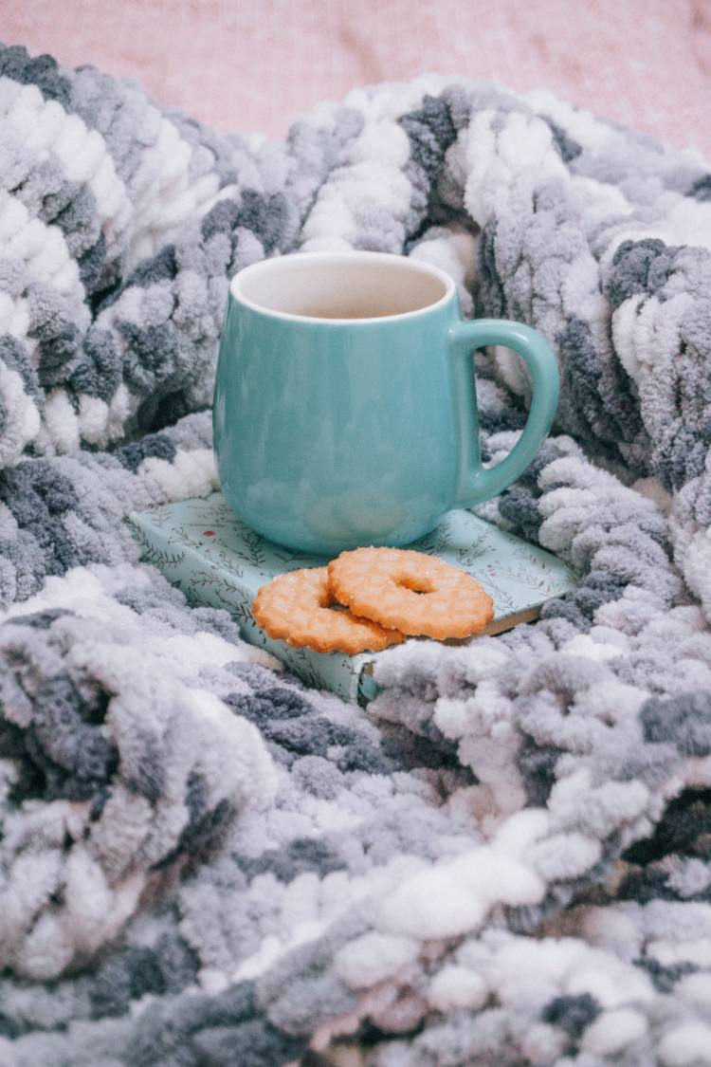
17. Chenille
The Plush Softness
Chenille, characterized by its plush, caterpillar-like yarns, is both visually attractive and soft to the touch.
This fabric is popular in cozy items like throws, blankets, and robes.
Its thick, soft piles create a deep texture, making it a great choice for decorative cushions and upholstery, adding a touch of coziness to any home décor.
Plush, soft fabric used in blankets and upholstery.

Slide 20
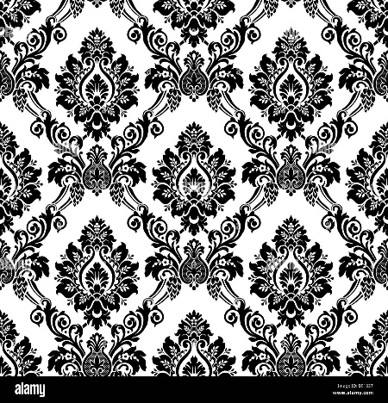
18. Damask
The Woven Elegance
Damask: Damask, known for its intricate patterns woven into the fabric, is a symbol of sophistication.
Originating in Damascus, it’s traditionally made from silk, cotton, or wool, featuring reversible patterns that catch the light differently on each side.
Damask is frequently used in high-end table linens, upholstery, and wallpaper, offering an elegant touch to interior designs.
Woven, elegant fabric used in home décor and table linens.

Slide 21
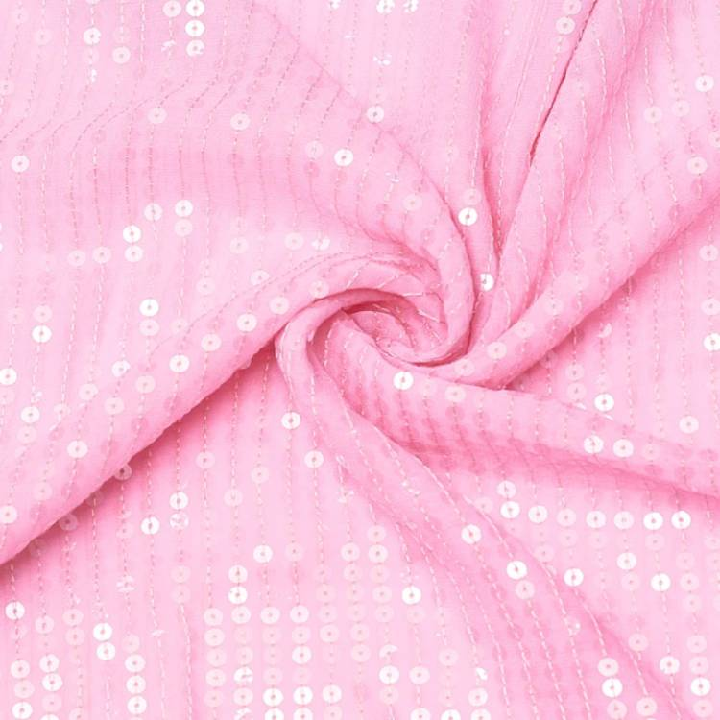
19. Georgette
The Flowy Lightweight
Georgette is a sheer, lightweight fabric, often made from silk or polyester, with a slightly puckered texture.
Its fluid drape makes it perfect for airy dresses, blouses, and scarves.
Georgette’s breathability and ease of dyeing in vibrant colors make it a popular choice for spring and summer fashion.
Flowy, lightweight fabric ideal for dresses and scarves.

Slide 22
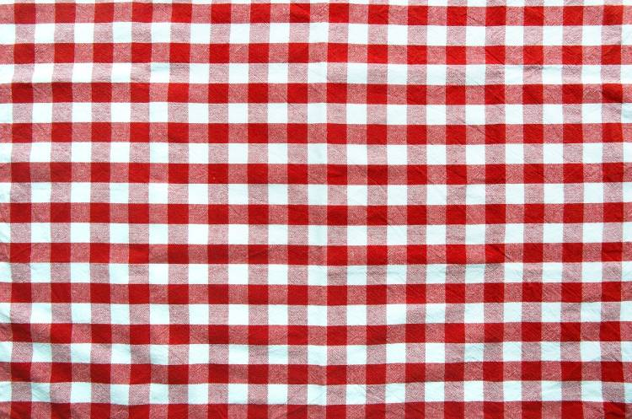
20. Gingham
The Classic Check
Gingham Fabric / Pixabay
Gingham: Gingham, known for its checked patterns in white and a bold colour, is a timeless fabric that exudes a sense of simplicity and charm.
Originally made from cotton or blends, it’s used in casual wear, tablecloths, and kitchen accessories.
Gingham’s association with cheerful, everyday simplicity makes it a perennial favorite in fashion and home décor.
Classic checkered fabric used in fashion and home accessories.

Slide 23
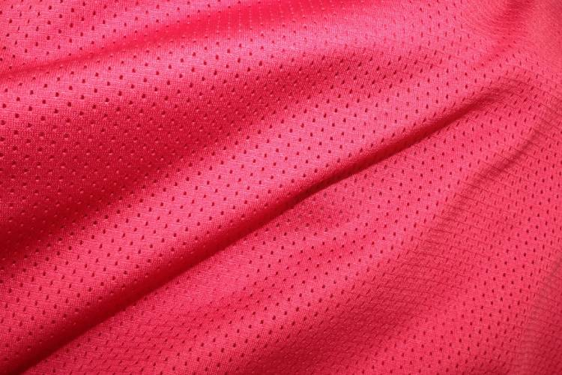
21. Jersey
The Comfortable Stretch
Jersey, originally made from wool but now often crafted from cotton or synthetic blends, is known for its stretch and softness.
It’s a staple in comfortable clothing like T-shirts, underwear, and sleepwear.
Jersey’s natural elasticity allows for freedom of movement, making it ideal for casual wear and sportswear.
Its ability to be lightweight or heavyweight also makes it versatile for various seasonal garments.
Stretchable, comfortable fabric used in T-shirts and sleepwear.

Slide 24
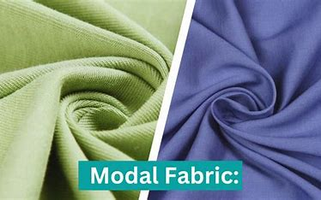
22. Modal
The Silky Performance
Modal fabric, made from beech tree fibers, combines the comfort of natural fibers with the practicality of synthetics.
It’s silky smooth, drapes well, and is resistant to shrinkage and fading, making it a popular choice for lingerie, activewear, and bed linens.
Modal’s moisture-wicking properties and breathability add to its appeal for garments worn close to the skin.
Soft, breathable fabric used in lingerie and bed linens.

Slide 25
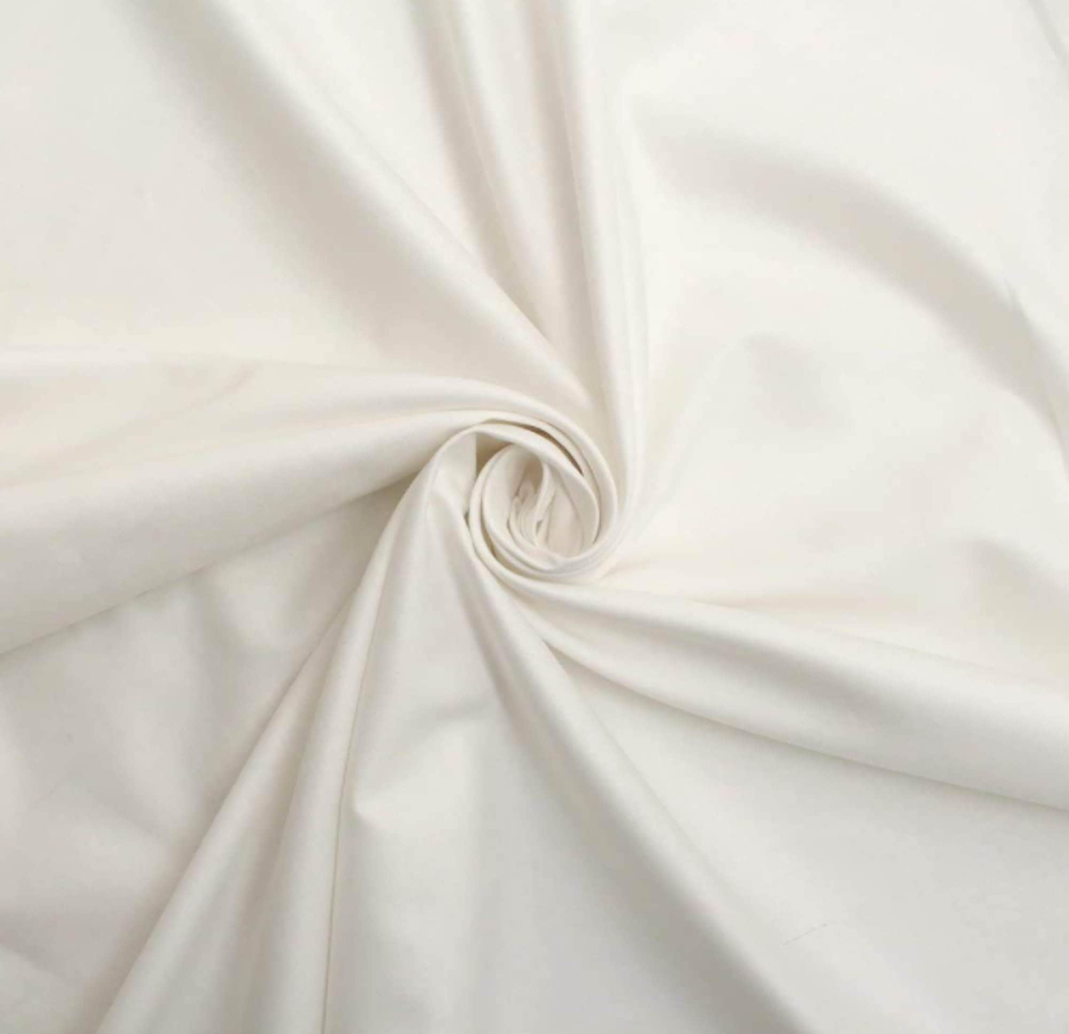
23. Percale
The Crisp Bedding
Percale refers to a closely woven, plain-weave fabric typically made from cotton or cotton-polyester blends.
Known for its matte finish and crisp feel, percale is a popular choice for bed linens.
It’s cool and breathable, making it especially comfortable for warm sleepers and summer bedding.
Its tight weave lends a smooth, durable quality that withstands repeated washing.
Crisp, closely woven fabric popular for bed linens.

Slide 26
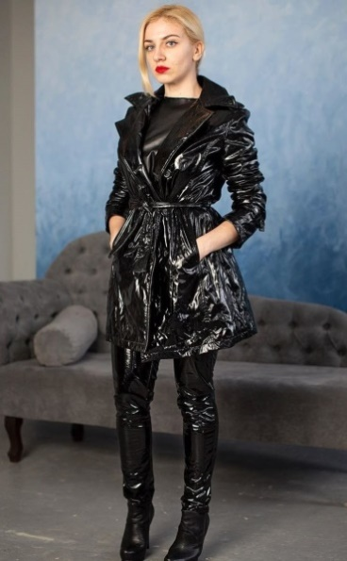
24. Vinyl
The Versatile Synthetic
Vinyl, a synthetic plastic material, is widely used in a variety of applications, from upholstery and clothing to records and signage.
Its water-resistant and easy-to-clean properties make it ideal for kitchen accessories, outdoor furniture, and rainwear.
Vinyl can be made soft and flexible or rigid and tough, allowing for a wide range of uses across industries.
Versatile, water-resistant synthetic material used in upholstery and clothing.

Slide 27
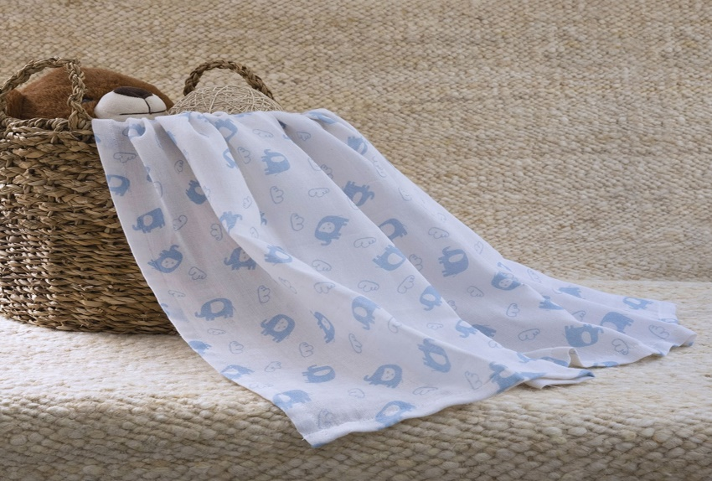
25. Muslin
The Lightweight Classic
Muslin is a plain-weave cotton fabric known for its lightweight, breathable, and soft nature.
It’s often used in sewing and pattern making, as well as for baby swaddles, lightweight curtains, and summer clothing.
Muslin’s ability to keep its shape and ease of dyeing make it a popular choice for both functional and decorative uses.
Lightweight, breathable cotton fabric used in baby swaddles and sewing.

Slide 28
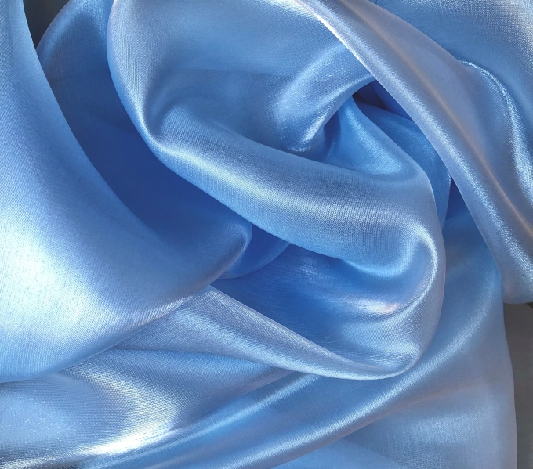
26. Organza
The Sheer Delicacy
Organza, a thin, plain weave fabric traditionally made from silk, is known for its sheer, lightweight quality.
It has a crisp drape, making it popular in bridal wear, evening gowns, and as a layering fabric in various garments.
Organza adds volume without weight, making it ideal for fuller skirts and dresses, as well as for decorative purposes in event décor.
Sheer, crisp fabric used in bridal wear and decorative elements.

Slide 29
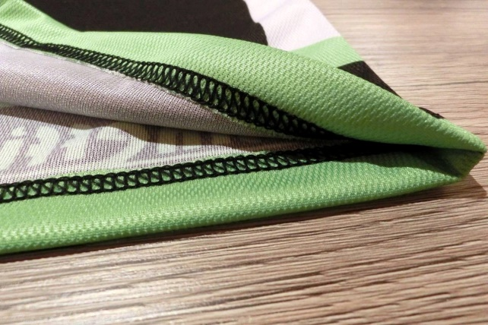
27. Polyester
Polyester Fabric / Pixabay
Polyester: The Durable All-Rounder
Polyester, a synthetic fabric, is celebrated for its durability, resistance to wrinkles and shrinkage, and quick-drying properties.
It’s widely used in a range of garments, from casual wear to outdoor gear, as well as in home furnishings.
Polyester’s ability to blend with other fibers enhances its versatility, making it a common component in various fabric blends.
Durable, wrinkle-resistant fabric widely used in fashion and furnishings.

Slide 30
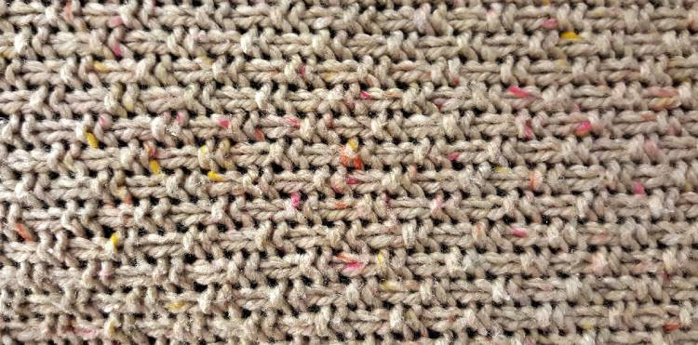
28. Rayon
The Versatile Fiber
Rayon: Rayon, a man-made fiber derived from cellulose, combines the comfort of natural fibers with the practicality of synthetics.
It’s soft, absorbent, and drapes well, making it suitable for a variety of garments including dresses, blouses, and jackets.
Rayon’s versatility extends to home textiles, where its silk-like feel is valued.
Soft, absorbent fabric blending natural and synthetic qualities.

Slide 31
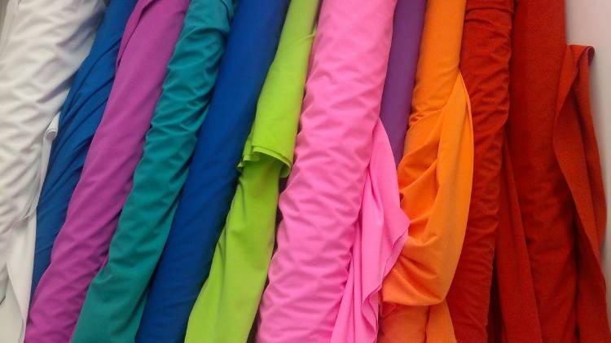
29. Spandex
The Ultimate Stretch
Spandex: Spandex, known for its exceptional elasticity, is a synthetic fiber that can stretch up to five times its length.
It’s essential in activewear, swimwear, and other garments where flexibility is key.
Spandex is often blended with other fabrics to add stretch and improve fit, enhancing comfort and range of motion in various clothing types.
Highly elastic synthetic fabric used in activewear and swimwear.

Slide 32
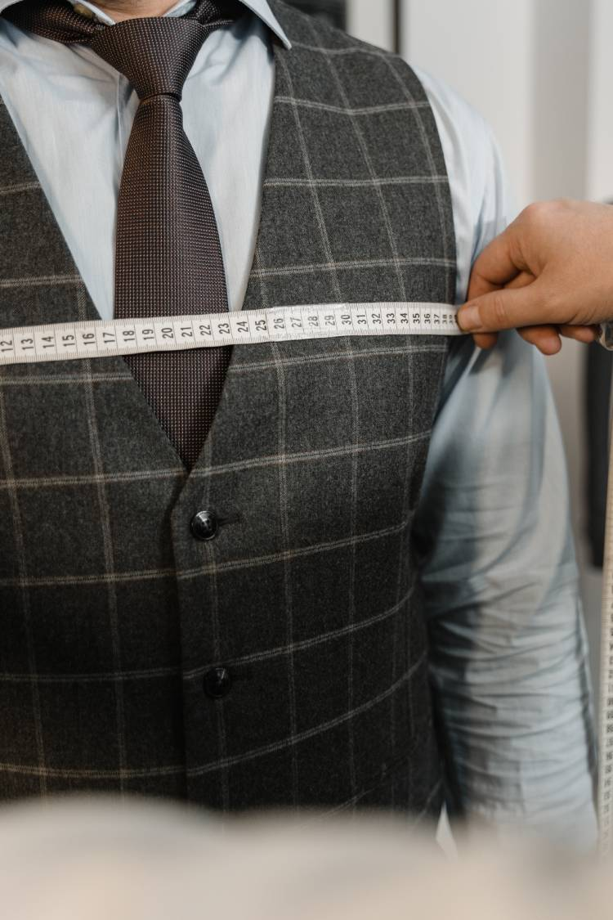
30. Hemp
The Eco-Friendly Choice
Hemp, a natural fiber, is gaining popularity for its environmental benefits and durability.
It’s used in clothing, accessories, and home furnishings, offering a strong, breathable, and absorbent alternative to traditional fibers.
Hemp’s sustainability, as it requires less water and pesticides than cotton, adds to its appeal in an increasingly eco-conscious world.
Eco-friendly, durable fabric used in clothing and home textiles.

Slide 33
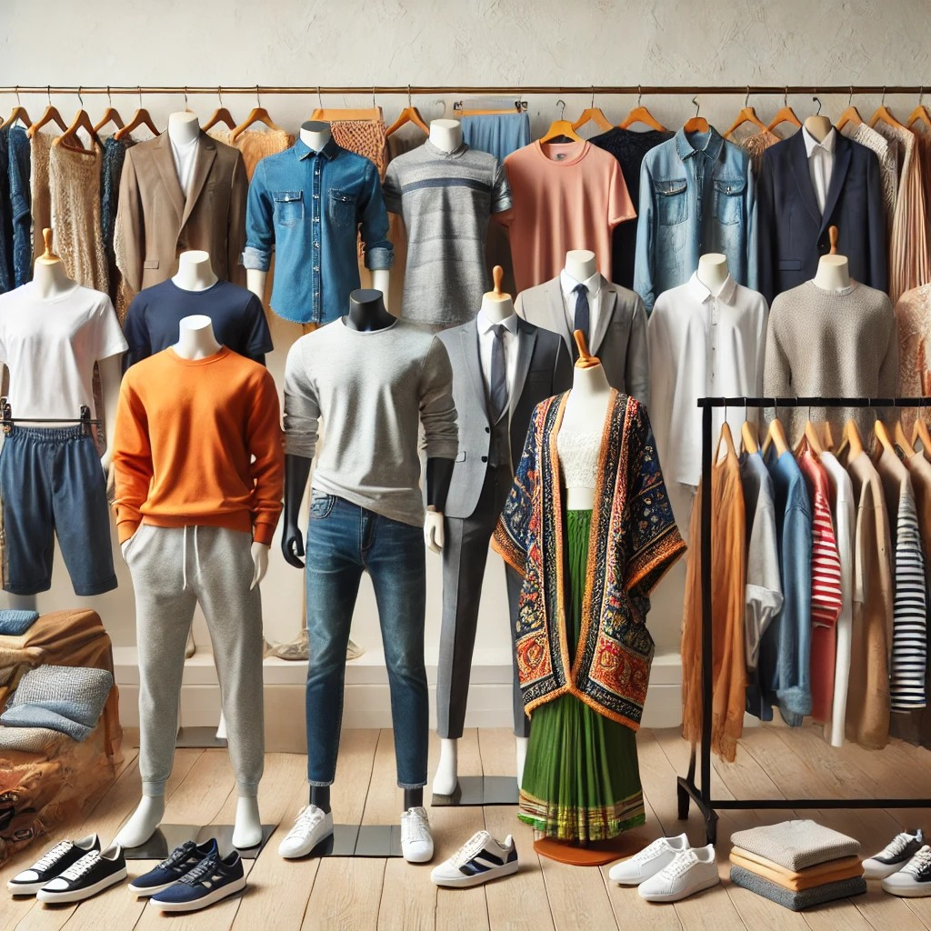
Textiles refer to materials made from fibers, threads, or yarns, woven, knitted, or bonded together to create fabric.
Made from fibers (cotton, wool, silk, polyester, etc.).
Produced through weaving, knitting, or other processes.
Used in fashion, upholstery, medical, and industrial fields.

Slide 34
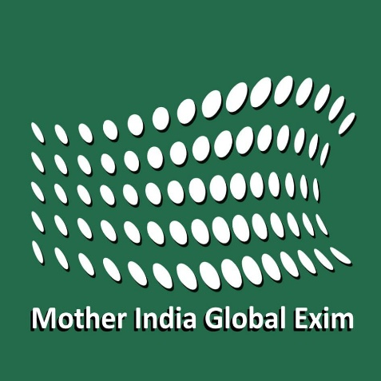

Ramprasad GVSS.,
Founder & MD.,
📞 +91 7386112277,
✉️ Email: cmd@motherindgroup.com | ramprawsadindia@gmail.com
🌐 Website: www.motherindiagroup.com

